Slide 1
JAVA FS : ECE & EIE 3rd Year
DAY 22
Abstract Class
Abstract Method

Slide 2
Java is an Object-Oriented Language. Java supports the following fundamental concepts:
Polymorphism
Inheritance
Encapsulation
Abstraction
Classes
Objects
Instance
Method
Message Parsing
Polymorphism : Abstract

Slide 3


Abstract classes– Polymorphism
Abstract

Slide 4
Java Data Abstraction
OOPs Concepts: Data Abstraction
In Object oriented programming Abstraction is a process of hiding the implementation details from the user,
only the functionality will be provided to the user.
In other words user will have the information on
what the object does instead of
how it does it.
In Java Abstraction is achieved using Abstract classes, and Interfaces.

Slide 5





Java Data Abstraction

Slide 6
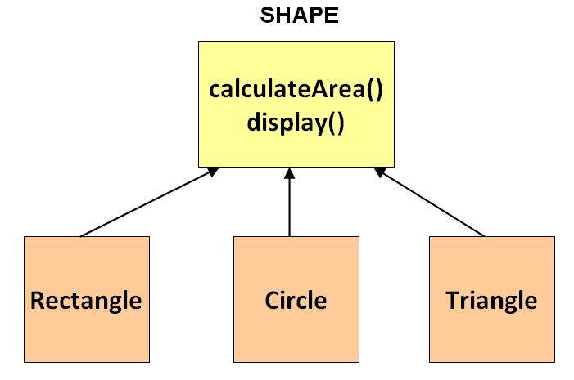
Abstract classes– Polymorphism
Abstract: Say every thing without giving details.

Slide 7
Polymorphism : Abstract
An abstract class is a class that is declared with the keyword abstract
It may or may not include abstract methods.
An abstract method is is declared with the keyword abstract
Abstract classes cannot be instantiated,
but they can be subclassed.
When an abstract class is subclassed, the subclass usually provides implementations for all of the abstract methods in its parent class.
However, if it does not, then the subclass must also be declared abstract.

Slide 8
Polymorphism : Abstract
When should you use, abstract classes?
Consider using abstract classes if any of these statements apply to your situation:
You want to share code among several closely related classes.
You expect that classes that extend your abstract class have many common methods or fields, or require access modifiers other than public (such as protected and private).
You want to declare non-static or non-final fields. This enables you to define methods that can access and modify the state of the object to which they belong.

Slide 9
Polymorphism : Abstract
A class which contains the abstract keyword in its declaration is known as abstract class.
Abstract classes may or may not contain abstract methods ie., methods with out body ( public abstract void get(); )
But, if a class have at least one abstract method, then the class must be declared abstract.
If a class is declared abstract it cannot be instantiated.
To use an abstract class you have to ????
inherit it from another class, provide implementations to the abstract methods in it.

Slide 10
Polymorphism : Abstract
Abstract method
Method that are declared without any body within an abstract class is known as abstract method.
The method body will be defined by its subclass.
Abstract method can never be final and static.
Any class that extends an abstract class must implement all the abstract methods declared by the super class.
Syntax :
Access Specifier abstract return_type function_name ();

Slide 11
Polymorphism : Abstract
abstract class A //Create Abstract Class
{ abstract void callme();/*Declare Abstract method*/ }
public class FsS1Abstract extends A
{//Create child from Abstract class
void callme() //Define Abstract method
{ System.out.println("this is call me."); }
public static void main(String[] args)
{
FsS1Abstract b=new FsS1Abstract();
b.callme();
}
}
output: this is call me.

Slide 12
Polymorphism : Abstract
Abstract class with instance method.
Abstract classes can also have instance methods with definitions, along with abstract methods.

Slide 13
Polymorphism : Abstract
abstract class A
{
abstract void callMe();
public void Instance ()
{ System.out.println("this is Instance method"); }
}
class B extends A
{
//Define Abstract method
void callMe()
{ System.out.println("this is Abstract method call Me."); }
public static void main(String[] args)
{ B b=new B();
b. callMe();
b. Instance ();
}
}
output:
this is Instance method.
this is Abstract method call Me.

Slide 14
Polymorphism : Abstract
Summary
Abstract class may or may not have abstract method(s).
If class has abstract method then the class has to be declared abstract.
Non-Abstract class cannot have abstract method.
Abstract classes can also have instance methods with definitions, along with abstract methods.
Abstract classes can have Constructors,
Member variables.
Abstract classes are never instantiated.
An abstract class may have static fields
Abstract class can have static methods.
When you extend Abstract class with abstract method, you must define the abstract method in the child class, or make the child class abstract.
Points to remember about abstract method: 1) Abstract method has no body. 2) Always end the declaration with a semicolon(;). 3) It must be overridden. An abstract class must be extended and in a same way abstract method must be overridden. 4) Abstract method must be in a abstract class.

Slide 15
Polymorphism : Abstract
WAJP using abstract class & methods.
Abstract class Shape should have two abstract methods getArea(double length) and getPerimeter(double length). Both methods should return a double and take double as a parameter.
In the extended classes Circle and Square define these methods and ensure that you display Area and Perimeter of circle and square in the main class.

Slide 16
Polymorphism : Abstract
abstract class Shape
{
protected abstract double getArea(double length);
protected abstract double getPerimeter(double length);
}
class Circle extends Shape
{
static final double PI = 3.14;
public double getArea(double radius)
{return radius * radius * PI;}
public double getPerimeter(double radius)
{ return PI * 2 * radius; }
}
class Square extends Shape
{
public double getArea(double side)
{ return side * side; }
public double getPerimeter(double side)
{ return side * 4; }
}
public class FsR2Abstract
{
public static void main(String args[])
{
Circle cle = new Circle();
//double a = cle.getArea(7.2d);
System.out.println("Circle Area: "+cle.getArea(7.2d));
}
}

Slide 17
Polymorphism : Abstract

Slide 18
Polymorphism : Abstract

